Slide 1
Natural Disaster Stress Testing
IS483 Final Presentation by Team Cycovid-20
Notes:
Afternoon Prof Wang Hai and Prof Poh Choo, it has been 5 weeks since our last meeting and we are here to update you about what we have done since midterms.

Slide 2






TEAM CYCOVID-20
Cedrick
Project Manager
Back-End Developer
Parth
Data Engineer
Jia Yu
Front-End Developer
Shivika
Software Architect
Xiaowei
Full Stacks Developer
Christine
Data Analyst
Notes:
Here is our team. You will hear from us soon throughout the presentation.

Slide 3
AGENDA
01
02
03
04
05
06
Research Overview
Solution Approach
Technical Details
- Problem Statement
- Project Motivation
- Impact of Cyclones
- Climate Change
- Pitch Video
- Use Case Diagram
- User Scenario Diagram
- Solution Model Comparison
- Data Collection & Analysis
- System Architecture
- Technical Complexity
- Data & Technical Challenges
UAT & DEMO
Project Management
Conclusion
- UAT Goals
- UAT Results
- Post UAT Changes
- Demo of Application
- Scheduled Timeline
- PM Approach
- Change Management
- Stakeholder Management
- Benefits for Sponsor
- Gap Analysis
- Future Steps
- Team Reflection
Notes:
Here’s the agenda for today. (give them a few secs to read)
Parth 1- 35
Jiayu 37-47
Cedrick 48-57
Christine 58-66
Xiao Wei 67-75
Shivika 76-84

Slide 4
Research Overview
01
Notes:
First, let’s start off with an overview of what the whole project is related about.

Slide 5
Problem Statement
What is the impact of typhoons to the economy under the effects of Climate Change?
Notes:
Our project surrounds the problem statement: What is the impact of typhoons to the economy under the effects of climate change?

Slide 6



Project Motivation
Understanding Effects of Climate Change
Risk Management
Damage Projection
Notes:
The motivation for CS and SMU team for this project came about from the need to
understand how the changing climate would affect specific natural disasters.
To know how the effects of typhoons and its risks could be managed.
And lastly to project damages for typhoons in the future.

Slide 7
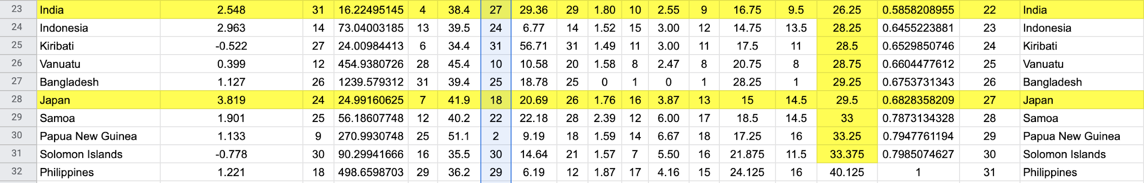
Japan & India - Weightage Analysis
Cycovid-20 Vulnerability Index:
Equation 1:
Equation 2:
Weighted each metric and calculate scores for each country
Japan (Developed Country) & India (Less Developed Country)
Category + Duration
GDP + Pop Density + Worldwide Gov Indicators
Notes:
Our Focus was to work on countries in the APAC region. To narrow down the list, we decided we wanted only one developing and one developed country. So we also did our own research and came up with our own equation to list out the counties based on their vulnerabilities. To do so we used the country’s GDP, Population density, multiple governance indicators, average cyclone durations, and average Categories to generate a ranking.
Initially we had decided to focus on Japan as our developed country and Philippines as our Less Developed Country, but we switched Philippines with India soon afterwards.

Slide 8
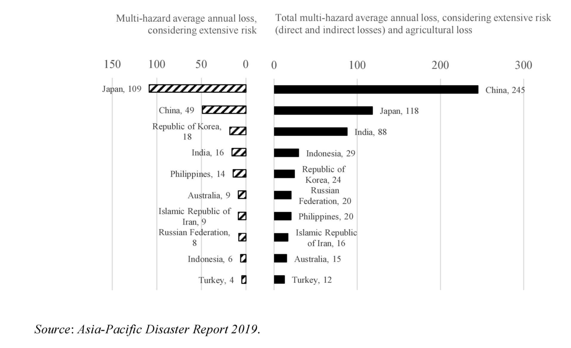
Why Japan and India?
Notes:
The reasons for this switch were the following:
We found out that India ranked much higher on yearly financial loss due to natural disasters such as cyclones
Client’s interest in northern india due to the recent cyclone amphan
Most observable climate change impact in Bay of bengal than compared to the ocean around philippines
Focus on a different water body (south pacific vs Indian ocean)

Slide 9
Case Study: India
The effect of time on cyclones in the bay of bengal
Notes:
So let's look into India as a case study for cyclones and Climate change. We found a lot of data and charts that raised a need for a typhoon dashboard.

Slide 10
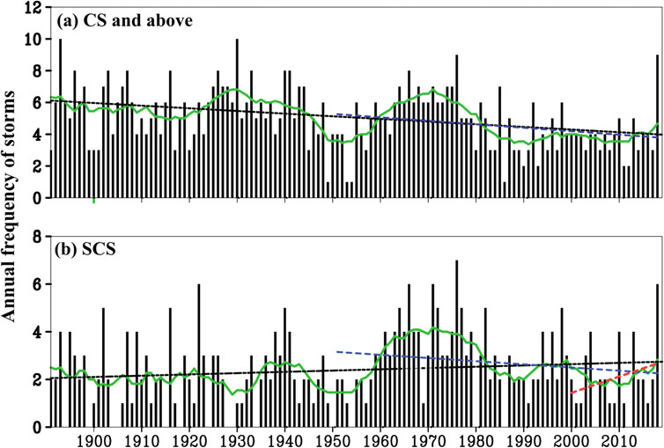
Frequency of Cyclones
Notes:
This the trend of frequency of cyclones in India until 2018, there is a clear increasing trend of the frequency from 2000-2018

Slide 11
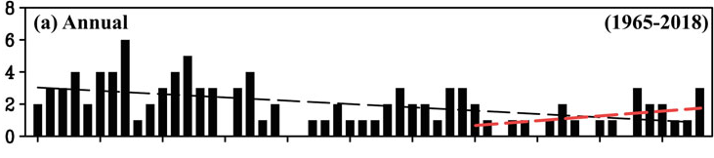
Intensity of Cyclones
2000
2018
Upward trend observed in the number of very severe cyclonic storms in recent years
Notes:
There is also a upward trend observed in the number of very severe cyclonic storms in the same time period for India.

Slide 12
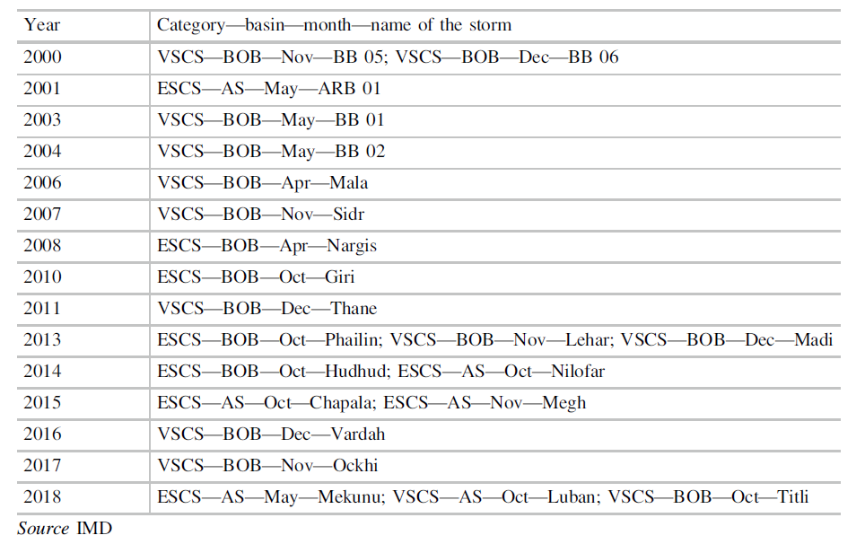
Intensity of Cyclones
Extreme category Tropical Cyclones observed over the Indian seas from 2000-2018
Observation: Increase in number of high intensity cyclones
Projection: Increasing intensity of cyclones in the future
Notes:
Furthermore, as you can see from the list of cyclones with category, the number of high intensity cyclones is increasing, and there are research showing that the number will keep increasing.

Slide 13
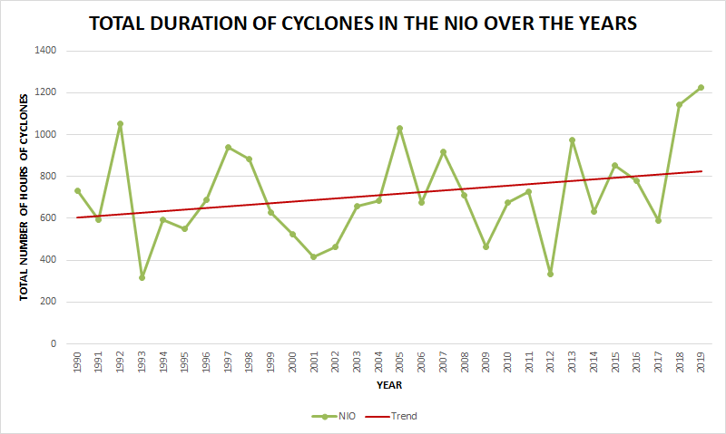
Duration of Cyclones
Evidence: An increasing trend is noticed in the total duration of cyclones occurred between 1990 and 2019
Conclusion: The duration of cyclones is increasing over time, which increases its impact
Notes:
Also for duration of cyclones, the trend is also increasing for cyclones. This translates to the longer time period of impact of cyclones and hence more damage

Slide 14
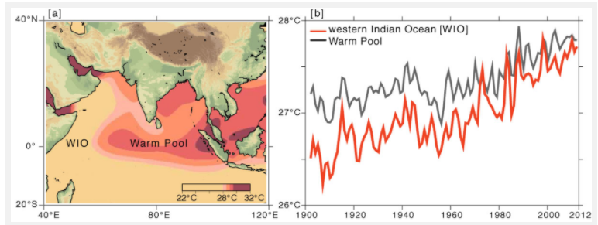
Temperature Rising
Notes:
Due to climate change, the temperature in westen indian ocean is clearly increasing over the years.

Slide 15
Temperature Rising
Higher temperatures lead to cyclones forming at a faster rate
Case with Phailin and Amphan
Warmer oceans signifies higher rainfall during storms
Increasing intensity of tropical cyclones
Notes:
And this will lead to more intense cyclones forming at a faster rate which was demonstrated by cases of Phailin and Amphan which will be mentioned later. Also, the warmer oceans will also lead to higher rainfall during storms. These will then contribute to the increasing intensity of tropical cyclones.

Slide 16
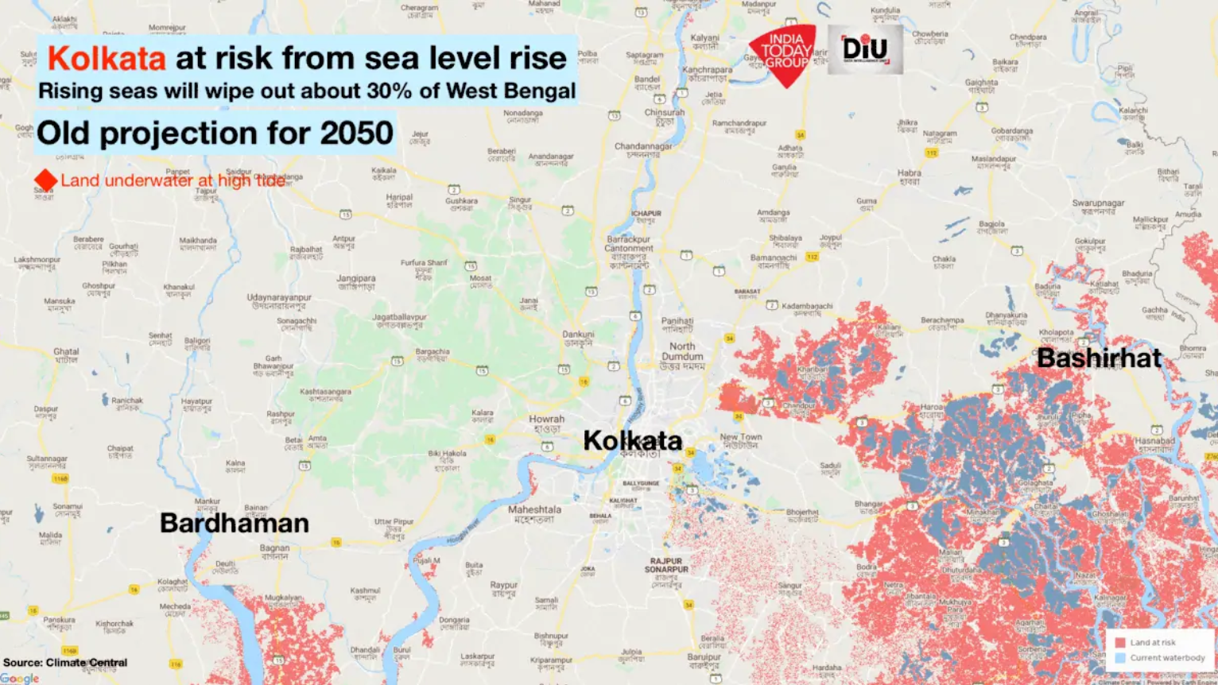
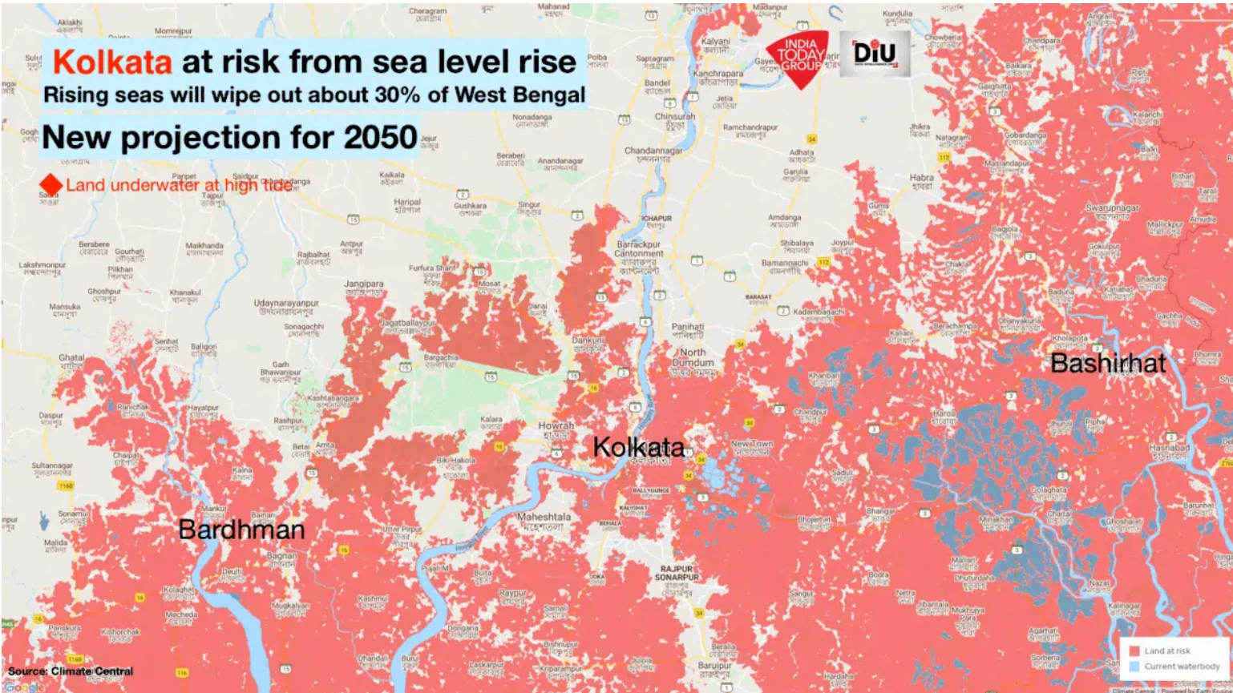
Sea Level Rising
Impact on densely populated low-lying coastal areas
Notes:
Moving on, the rising sea level observed in India, it will affect the densely populated low-lying coastal areas. As you can see from the comparison of regions at risk from sea level rising.

Slide 17
Sea Level Rising: India
Increasing vulnerability:
Higher storm surges due to rising sea level
Impact on larger inland areas
High population density
E.g. India is projected as the largest in the world by 2030
Fragile infrastructures
Notes:
Under such conditions, storm surges will be higher which will generate impact on larger inland areas. And due to the high population density, and fragile infrastructures in India, the areas will be more vulnerable to impact of cyclones.

Slide 18
Cyclones in India
Focus on two Cat 5 cyclones 7 years apart:
Cyclone Amphan
Cyclone Phailin
Goal: To quantify time and climate change effects on bay of bengal cyclones
Notes:
Now we will talk about real life example india to illustrate quantitatively the correlation between climate and typhoons. We choose two typhoons 7 years apart.

Slide 19
Comparisons
Factor | Amphan | Phailin
CAT | 5 | 5
Death Toll (ppl) | 128 | 44
Evacuations (ppl) | 2,000,000 | 550.000
Year | 2020 | 2013
Global Temperature increase (*c) | 0.99 | 0.68
Sea level increase (mm) | 95.4 | 65
Damage (USD$Bln) | 13.9 | 1.469
GDP | 2,610,000,000,000.00 | 1,856,720,000,000.00
Damage % of GDP | 0.5 | 0.07
Notes:
Here are the numbers to notice. In 7 years, the global temp rose by 0.3*c, the sea level increased by 30 cm and the damage was recorded to be 10 fold. As explained there is definitely correlation and causation here between damage and CC. What's more alarming is that the damage as % of gdp had increased by 10x times too. The need for an application to somewhat visualise this effect is what need to fulfil during this FYP.

Slide 20



What can affect Cyclones?
Currently there are three main factors that can disrupt natural cyclone formations:
Greenhouse Gasses and Sea Levels
Polluting Particulates and Aerosols
Volcanic Eruptions
Notes:
We also want to mention that these three factors:
Greenhouse gasses and rising sea levels
Particle pollutions
And massive particle releasing natural disasters like volcanoes
Have a lot of impact on the frequency and intensity of Typhoons

Slide 21
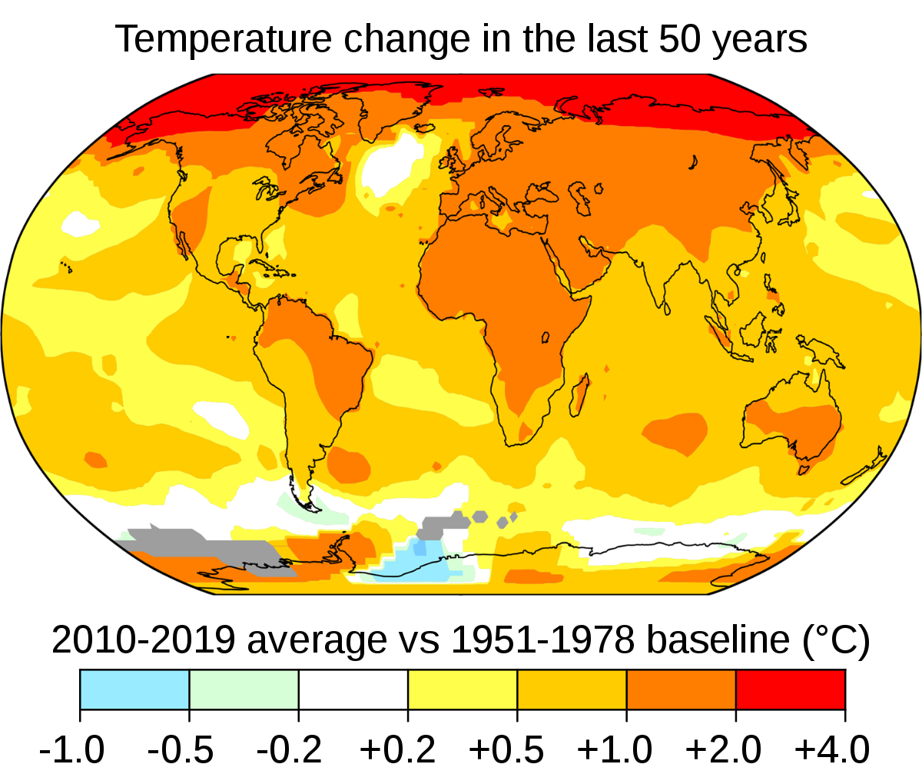
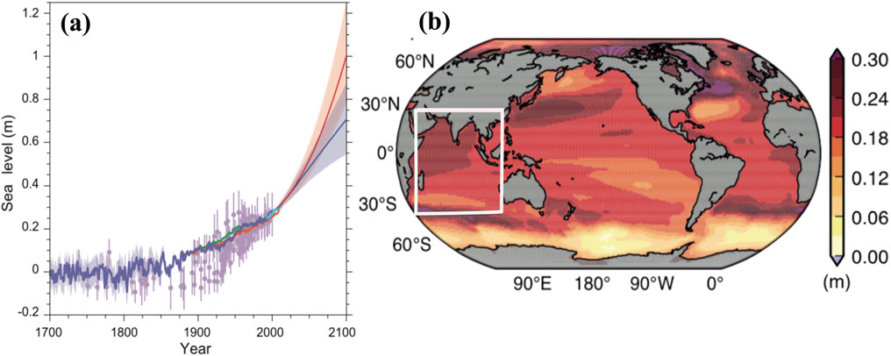
Global Climate Change
Increase in temperature
Rising sea level
Impacts of climate change are not increasing uniformly globally
Notes:
And with data to prove that sea tem and levels are rising, climate change’s effects on typhoons are going to accelerate and worsen. Sadly not consistently around the world.
Combine slide 10 and 11 - form the bridge highlight cause of this 2 reasons we want to work on india, key factors impacting typhoon 1 is sea level rising 1 is temperature. Draw sea level and temp to cyclone (must pass the msg that there’s a strong link on it)
Emphasise on message → the 2 factors
Reason 1 of zooming into India
Sea Level Rising: Projection until 2100
The highest changes is observed in North and western tropical Indian Ocean and western pacfic region
Mean sea-level change of about 0.25–0.3 mm

Slide 22
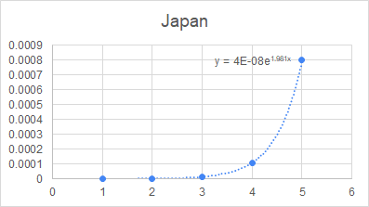
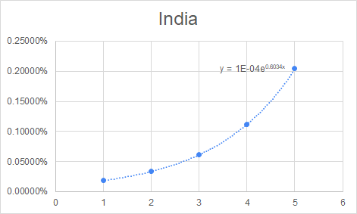
Data Models and Damage Functions
Why GDP?
There is a correlation between GDP and Produced Capital
GDP: measure of goods and services produced
Produced Capital: machinery, building, equipment used to produce goods and services
(from WorldBank)
X = category of Typhoon
Y = Damage/Annual GDP x 100 (%)
Notes:
All our research and modeling were funnelled into these two charts. These are equations for damage/annual GDP of a country for each CAT of a typhoon. The way we calculated this equation was through scraping damage data on historical cyclones. We calculated the percentage impact to GDP for each of the cyclones we researched on and then we averaged them out by category to get the average damage caused by cyclones in each category.
Source: https://climada-python.readthedocs.io/en/stable/tutorial/climada_entity_LitPop.html
Since GDP is a measure of the goods and services produced in the country and Produced capital is the machinery, buildings and equipment in which these goods and services are produced, we feel that an estimated impact to GDP will be a good estimate for produced capital as well.
X-axis: category
Y-axis: percentage damage = damage/annual GDP (by category)

Slide 23
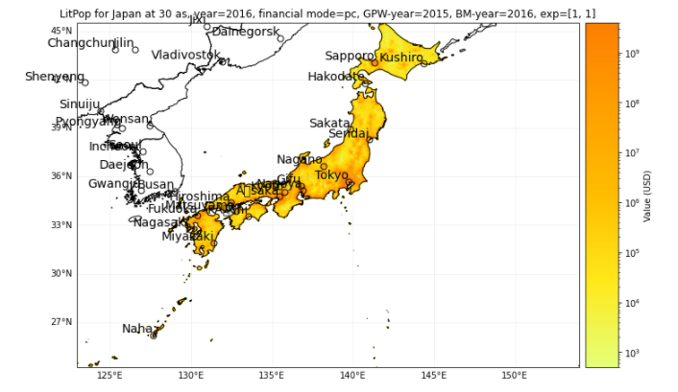
Damage Definition
X
Exposure of asset data → Produced capital value
Percentage damage based on category
Produced Capital damage per Prefecture
Notes:
Use exposure of assets data from climada and distribute produced capital value proportionally
Choose percentage from previous table based on category
Multiple percentage with value for prefecture
Add all prefecture values
Total damage !!
PC damage per prefecture
Since GDP is a measure of the goods and services produced in the country and Produced capital is the machinery, buildings and equipment in which these goods and services are produced, we feel that an estimated impact to GDP will be a good estimate for produced capital as well.

Slide 24
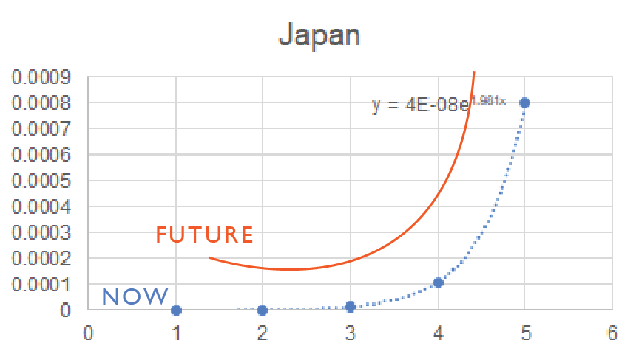
Climate Change Impact on Damage Function
Notes:
As mentioned the blue line indicates our current impact function and the orange line is what we predict will be the damage function 30-50 years from now due to the effects of climate change. We have plotted the estimated projection of damages for the future based on our understanding from the research we have conducted. We will explain why in the next slide.

Slide 25
Climate Change & Tropical Cyclone
Climate change affects the Frequency, Intensity, and Duration of cyclones
Hence, it is a necessary factor that should be considered when predicting future cyclones and their impact
Fully understand the impact of future cyclones to make better informed business decisions
Historical events and simulation of cyclones
Notes:
Climate Change:
Temperature of the sea is predicted to rise year on year
the greenhouse effect brings the upper atmosphere temperature higher
Cyclone intensities are predicted to increase by up to 10% yearly
Government and financial institutions need to be aware of these models
They need to realise and visualize the correlation between the rising sea level and the damage done in the region.
Just a 7 year difference and a 0.31*c difference in temperature(link) caused USD$12.5billion difference in damages.
Partly due to the expansion of cities, population growth and the explosion of businesses and commerce, it's no doubt that climate change has increased a cyclone’s ability to devastate everything in its path.
We need a dashboard to fully understand and visualise the impact of the future cyclones.
This would help make informed decision when expecting a typhoon to hit

Slide 26
Financial Implications
Visualisations to aid simulation and modelling of intense scenarios to predict potential damages
Preparation for higher liquidity risk and market risks
By being qualitative prepared, they would know to protect their investments and pull out of commitments in the bay area
They could take advantage of the shortages in production of different food types and reinvest when the storm has passed
Notes:
Financial Evaluation → “Implication”: the content here is more like a use case/implication
Banks and financial institutions need to use visualisations to simulate and model more intense scenarios to predict the damages.
Preparation for higher liquidity risk and market risks
For example, West bengal is the biggest producer of rice in india, second largest potato producer and owns 30% of the tea production in india. By being qualitative prepared, they would know to protect their investments and pull out of commitments in the bay area.
They could take advantage of the shortages in production of these food types and reinvest when the storm has passed.

Slide 27
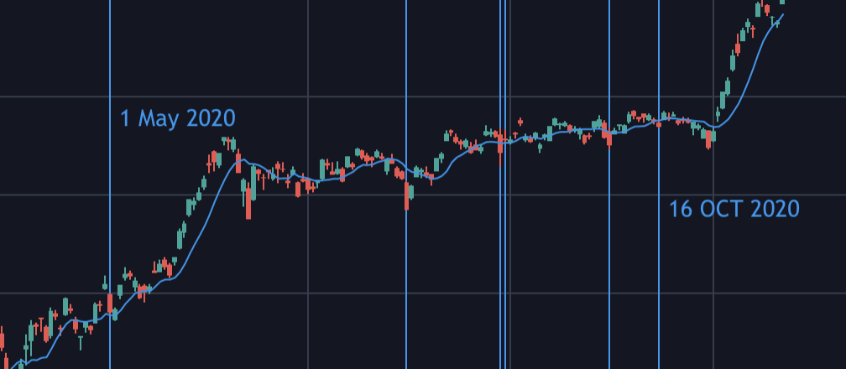
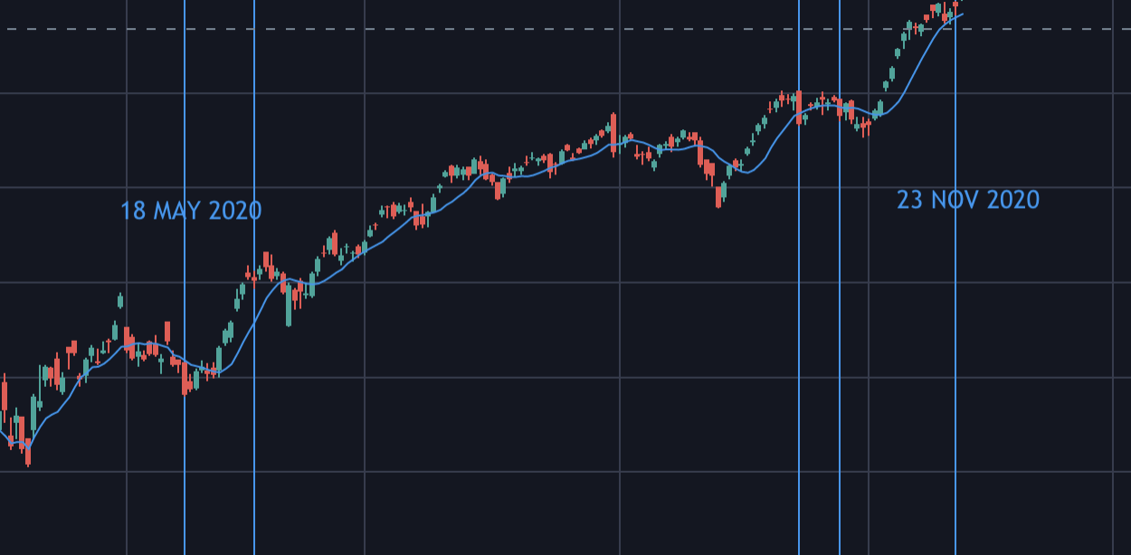
Stock Market Correlation
Nikkei 225 Index (JAPAN)
Average change during Typhoon: -1.49%
NIFTY 50 Index (INDIA)
Average change during cyclones: -1.612%
Notes:
To illustrate the point regarding market risk, we have taken the candlestick charts of the two biggest stock indexes in india and japan. On the right side we have the Nikkei 225 from japan. Each blue line represents a typhoon making landfall in japan this year between may till now. We calculated the avg daily change during each typhoon and it turned out to be about -1.5%. This phenomenon was also observed in NIFTY 50 the biggest stock index in India.

Slide 28



Why Do We Visualise Cyclones?
Quantify Climate Change
Predict & Prepare Financial/Economic Impacts
Learn from Historical Data
Notes:
Hence to conclude, the point of this research is we need a application or a dashboard to
quantify our climate change research
Help CS prepare and predict damages and risk in the financial/economic aspects
And learn from previous typhoon so that they can prepare for the next one
Pt 2: Don’t go in-depth, briefly mention the observation (macro level)
Climate Change:
Temperature of the sea is predicted to rise year on year
the greenhouse effect brings the upper atmosphere temperature higher
Cyclone intensities are predicted to increase by up to 10%.
Government and financial institutions need to be aware of these models
They need to realise and visualize the correlation between the rising sea level and the damage done in the region.
Just a 7 year difference and a 0.31*c difference in temperature(link) caused USD$12.5billion difference in damages.
Partly due to the expansion of cities, population growth and the explosion of businesses and commerce, it's no doubt that climate change has increased a cyclone’s ability to devastate everything in its path.
FIN:
Banks and financial institutions need to use visualisations to simulate and model more intense scenarios to predict the damages.
They need to prepare for higher liquidity risk and market risks
For example, West bengal is the biggest producer of rice in india, second largest potato producer and owns 30% of the tea production in india. By being qualitative prepared, they would know to protect their investments and pull out of commitments in the bay area.
They could take advantage of the shortages in production of these food types and reinvest when the storm has passed.
History
Need take a look at previous cyclones in Japan and India
Understand their paths and damages
Identify regions in the country that are the most vulnerable
Identify patterns to ramp up prevention efforts
Link to our application

Slide 29
Pitch Video
An introduction to our solution

Slide 30
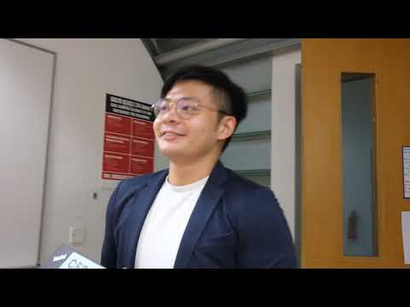

Slide 31
Solution Approach
02
Notes:
I hope you have enjoyed our pitch video. I’ll now be walking you through our solution approach to get a better understanding of how our application works.

Slide 32


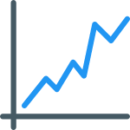

Features of Solution
Visualize Historic Cyclone Paths and Damages
Simulate a Cyclone and Assess its Damage
Assess the Impact of Climate Change on Frequency of Cyclones
View Asset Spread Across the Country
Notes:
Our proposed solution enables users to
Visualise historic cyclone paths and the damages incurred
Simulate cyclones and assess their damages
Assess the impact of climate change on frequency of cyclones
And easily view asset spread across the country

Slide 33
Use Case Diagram
View historical total and category typhoon count
Selects year
View asset value and asset value scale
Selects year, prefecture, category
Visualize paths of historical typhoon & damage caused
User
Add/Remove prefectures
Visualize environmental factors and typhoon counts
Selects coordinates
Visualize simulated typhoon path & projected damage caused
Notes:
Our application contains 5 main components whereby users would be able to
View historical typhoon counts - total and category counts, upon selection of the year
View asset values of individual prefectures as well as the overall asset value spread across Japan
Users are able to visualize paths of historical typhoons and the corresponding damages caused in USD with the year, prefecture and categories as the main identifiers
The visualisation of environmental factors and typhoon counts with the addition and removal of prefectures allows identification of plausible trends
Users can visualise simulated typhoon counts and the projected damage caused upon selection of coordinates on the map

Slide 34
User Scenario Diagram
Notes:
To better understand the entire user experience of our application, we have prepared the following user scenarios.

Slide 35



User Scenario Diagram - View historical typhoon count based on year
1. Selects year from dropdown list
2. Gets number of typhoons based on year selected
CYCOVID
Dash UI
5. Displays total typhoon count based on category
USER
Credit Suisse Risk Analyst
3. Returns overall typhoon count for selected year
4. Returns typhoon count for respective categories for selected year
CYCOVID
Python Backend
Notes:
To view historical typhoon counts based on their years, users can
Select the year from the dropdown list
The overall typhoon count as well as the count for the respective categories are then returned
Our dashboard then displays the counts for users to view

Slide 36
User Scenario Diagram - Visualise historical typhoon paths
1. Selects year
6. Selects prefecture & category from dropdown list
2. Gets typhoons for that year
3. Generates paths for typhoons
7. Gets SID for specified typhoon
8. Generates paths for specified typhoon
9. Gets total damage caused ($)
5. Displays visualization of typhoons in year selected
12. Displays selected typhoon path
13. Displays damaged caused
CYCOVID
Dash UI
USER
Credit Suisse Risk Analyst
4. Returns visualisation of typhoons based on selected year
10. Returns selected typhoon path
11. Returns damage caused
CYCOVID
Python Backend
Notes:
For the visualisation of historical typhoon paths
Users select the year and the typhoons for that year are being fetched. A visualisation of the typhoons and their respective paths based on the year selected is then returned. Upon selection of the prefecture and category from the dropdown list, the ID for the specific typhoon is retrieved and the path is being generated along with the total damage caused recorded in USD.

Slide 37
User Scenario Diagram - Visualise Asset Values
1. Hovers over map of Japan
2. Gets ID & asset value scale
4. Displays asset value scale data in tooltip
CYCOVID
Dash UI
USER
Credit Suisse Risk Analyst
3. Returns ID & asset value scale
CYCOVID
Python Backend
Notes:
To visualise asset values, users can hover over the map of Japan, whereby the ID of the prefectures and their corresponding assets values are being fetched and rendered on the map with the aid of the tooltip.

Slide 38
User Scenario Diagram - Visualise environmental factors and typhoon counts
1. Adds/drops prefectures from existing list
2. Gets average temperature for selected prefectures
3. Gets average precipitation for selected prefectures
CYCOVID
Dash UI
5. Displays generated visualisation
USER
Credit Suisse Risk Analyst
4. Returns visualisation for temperature and precipitation plotted against total typhoon counts for Japan
CYCOVID
Python Backend
Notes:
Moving on, Users are also able to visualise the correlation between typhoon counts and environmental factors.
By adding and dropping the prefectures from the existing list, the average temperature as well as the average precipitation is being processed and the visualisation for the temperature and precipitation of the selected prefectures are being plotted against the typhoon counts for Japan.The dashboard then renders the visualisation on the page for users for potential identification of trends and relationships between the environmental factors as well as the occurrence and frequency of typhoons.

Slide 39

User Scenario Diagram - Simulate Typhoon Tracks
1. Selects coordinates on map
4. Select ‘simulate damages’
6. Sends request containing lat & lon of coordinates
WEB API
Reverse geocoding
5. Sends coordinates
of selected points
2. Displays visualisation of lat & lon
3. Displays visualisation of path formed from selection(s)
9. Display total damage($)
CYCOVID
Dash UI
USER
Credit Suisse Risk Analyst
7. Returns translated prefecture based on inputted lat & lon
8. Returns total damages from selected path
CYCOVID
Python Backend
Notes:
Our simulation of typhoons invokes the utilisation of the Web API BigData Cloud.
Users can select respective coordinates on the map
And our dashboard renders the visualisation of the points and plots out the path formed from the selected points
The selection of ‘simulate damages’ button triggers the sending of the selected coordinates to our python backend
A request containing the latitude and longitude of the selected coordinates is sent and reverse geocoding is executed to translate all these coordinates to their corresponding prefectures
Our backend is then able to make use of these prefectures to render the total damages caused
The overall damage for the plotted typhoon is then displayed
Now i’ll be passing my time over to Cedrick to share more about our solution models.

Slide 40
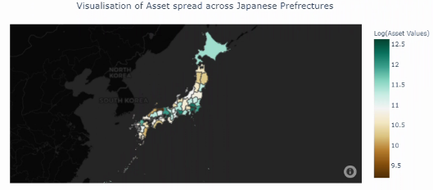
Solution Model Comparison
Before
After
Notes:
Before and after screenshots of what we did for the app

Slide 41
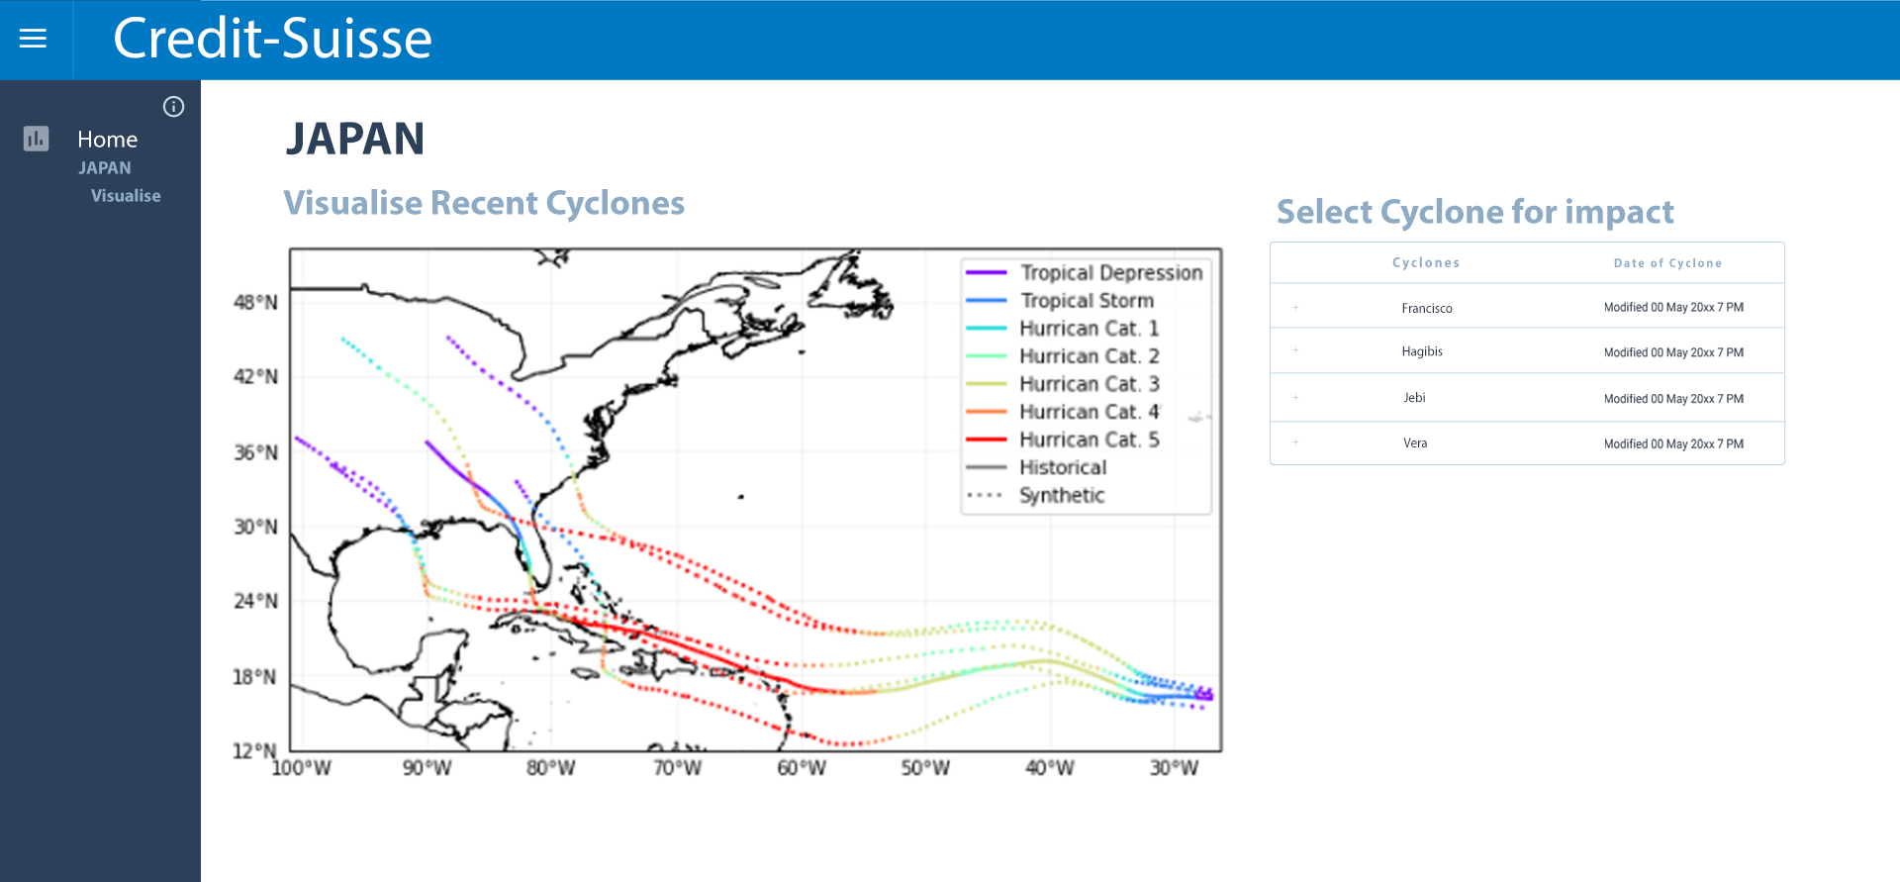
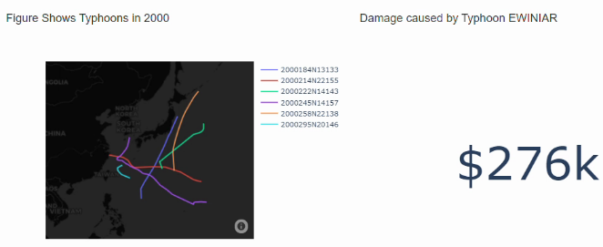
User Interface
Before
After
Notes:
And this is to visualise the recent cyclones and regional impact

Slide 42
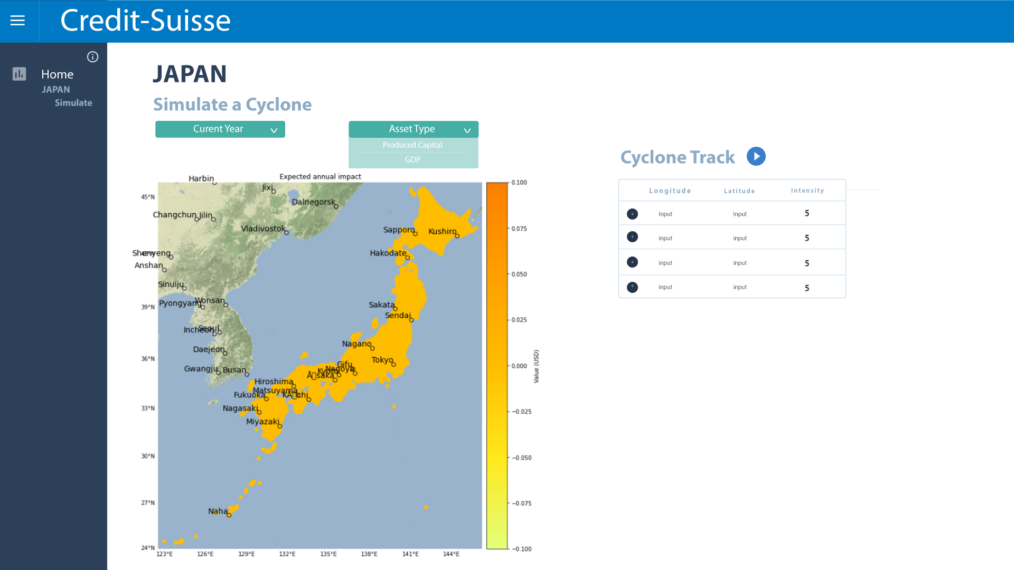
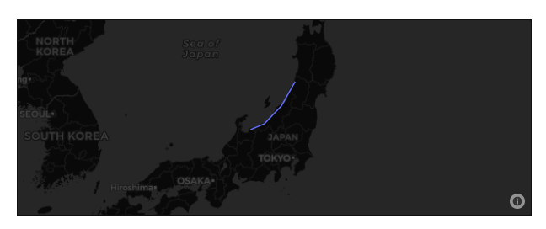
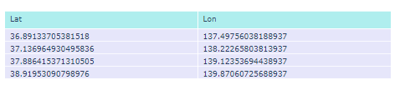
User Interface
Before
After
Notes:
The user can also export all these data for reference. Last but not least, the user can also simulate a cyclone by selecting the inputs. More details about our UI will be explained later in the technical part. Now I will pass my time to Christine.

Slide 43
Technical Details
03

Slide 44






Data Collection / Analysis
Data Sources:
AON damage reports
News Articles
Research Papers
Japanese Meteoric Society
IBTRACS
Insurance reports
WHO
Climada Library
TradingView
Worldbank
Tradingeconomy
Nat Geo
OECD
Credit Suisse Earthquake Report
Notes:
Climada - data processing

Slide 45



Summary of Analysis Methods
Exploratory Data Analysis
Basic understanding of variables
Normalisation
Vulnerability Ranking Analysis
Identify 2 vulnerable countries
Regression
Damage function
Best Fit exponential line
Damage function (percentage damage)
Data Cleaning
Exploratory Data Analysis
Cleaning data
Geocoding API
Reverse Geocoding for translation of coordinates to prefectures
Exploratory Data Analysis
Heatmap visualization of historical cyclones
Notes:
Python
Power BI

Slide 46













Tools & Framework
(Midterm)
(Final)
Programming Language
Database
Programming Language
Database
Software & Tools
Frameworks & Libraries
Software & Tools
Frameworks & Libraries

Slide 47







Web Application Architecture (Midterms)
Web Application Architecture (Midterm)
Query
POST
Web Server
Flask App
Display Results
What the User Sees
GET
- Update Database
& Files (annually
& every 5 years)
- Patch Application
Logic
User
Application Logic
Dev
FRONTEND
DataBase & Files
NC,CSV,Excel,TIF,H5,mat
BACKEND

Slide 48
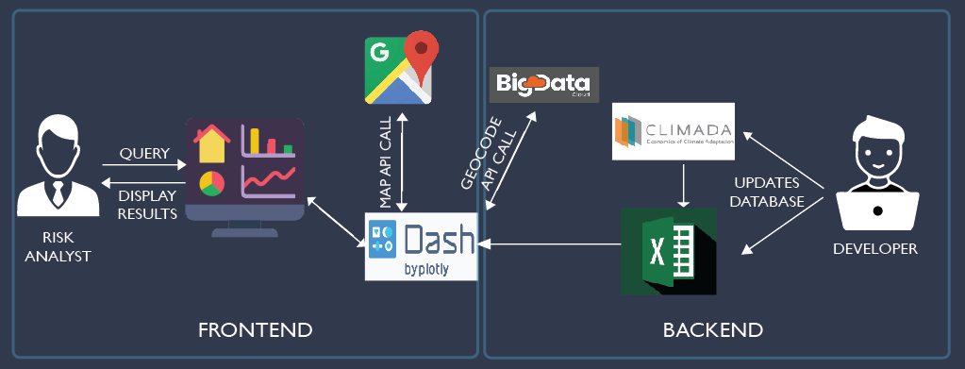
Web Application Architecture (Final)

Slide 49
Data Challenges
01
02
03
Large datasets
Niche Datasets
Manual Data Cleaning
- Unable to get the same amount of data for some of the metrics used
- Long time needed to load & process data
- Inconsistent formatting of dataset
- Eyeballing to understand application
- Gathering Qualitative data to tweak country-specific functions (e.g Impact)
Notes:
Translation of coordinates to specific prefectures
Some data challenges we have encountered along the way
Large datasets -
unable to get same amount of data for some metrics → inability to properly note down everything due to missing values
Long time needed to load and process all the data due to its large size
Working with very niche datasets
Manual Data Cleaning and pre-processing
Had to gather qualitative data separately in order to tweak country-specific functions such as the impact function that we are working on

Slide 50
Technical Challenges
01
02
03
API Calls Inaccurate
Issues with Solution Architecture
Library Installations
- Being unfamiliar with different frameworks, we found ourselves jumping between django, html + vanilla JS to flask and finally plotly dash
- libraries in makefile offered incompatible versions and lead to issues running climada
- Format of API Calls gave inconsistent Json outputs. This lead to data inaccuracies. Wrong prefectures, Old naming convention
Notes:
Issues with solution architecture: Unfamiliarity with the different frameworks has led us to

Slide 51
Technical Challenges
04
05
Issues with Solution Architecture
Use of Niche Python Libraries
- Plotly was unable to take on click-inputs so we had to find a solution through overlaying google maps to retrieve longitude and latitude values
- lack of documentation lead to plenty of time spent on self learning the concepts

Slide 52
UAT & DEMO
04
Notes:
Thank you Cedrick. The next thing that we have done is to conduct UAT where we want to ensure that the application is able to perform the required functionalities in real world context.

Slide 53


User Acceptance Testings (UAT) Goals
15-20 users (Students / General public)
To confirm that the application is usable from an end user perspective
To identify and resolve any bottleneck in completing tasks
Notes:
Our goal was to conduct UAT with at least 15 users to verify that the web application is usable from their perspective as well as to identify and resolve any bottlenecks in completing the tasks.

Slide 54
Application Goals
Both Clients and users will be able to:
 | Visualise historical typhoons based on various categories
 | Simulate typhoons based on their selected coordinates
 | Identify damage reports (asset values)
 | Identify prefectures with high frequencies of typhoons
 | Visualise typhoons occurrence in relation to average temperature and precipitation per year
Notes:
Moving on, these are some of the goals that the application aims to provide. Visualise historical typhoons based on various categories, Simulate typhoons, view damage asset values based on prefectures, identify prefectures based on their frequency count and typhoons occurrence in relation to average temperature and precipitation.

Slide 55
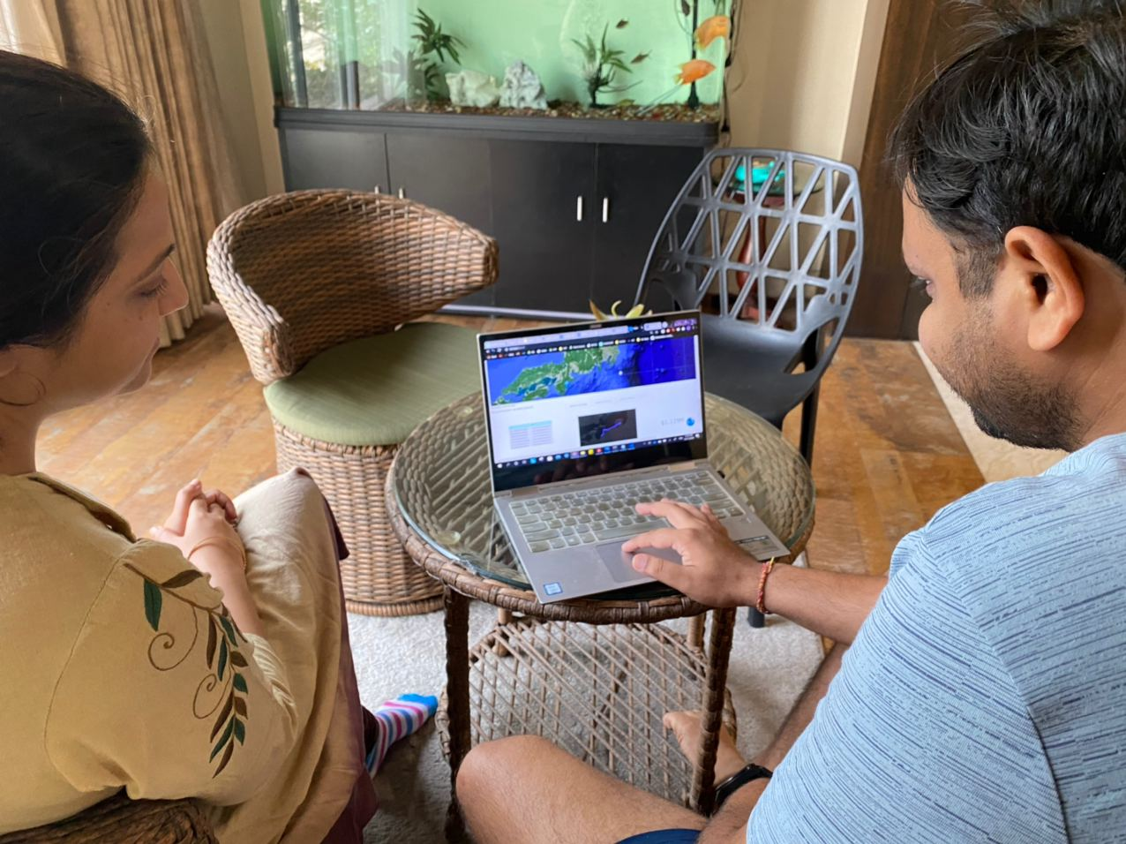
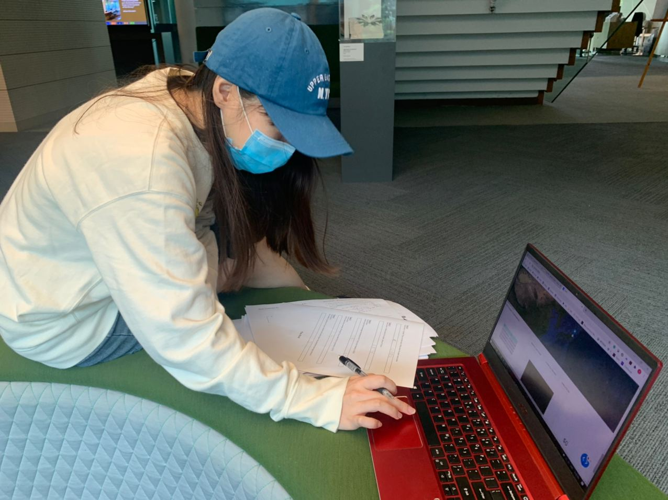
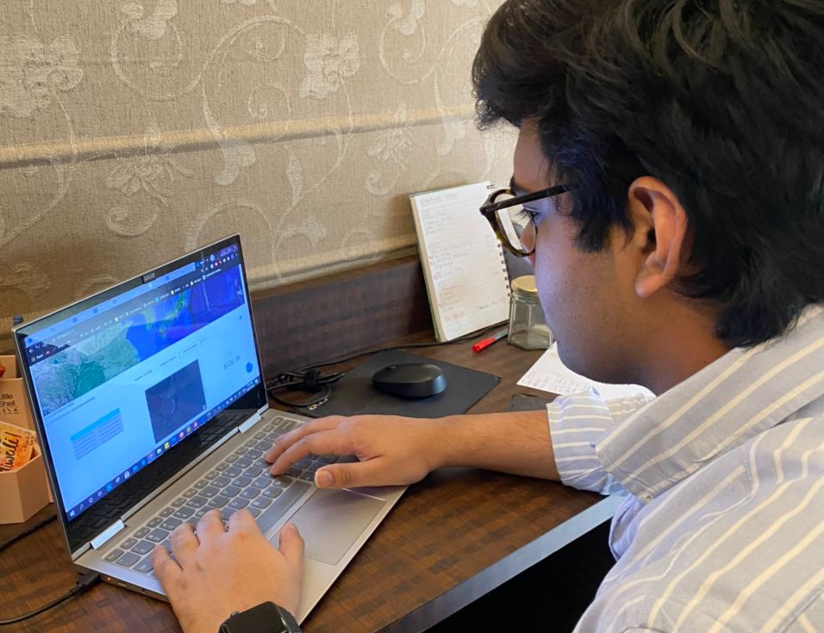
Conducting UAT
Notes:
These are just a few pictures of our users

Slide 56
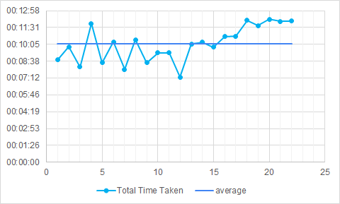

UAT Results (1st round)
Average time taken to complete 8 tasks is ~10 minutes
Number of users: 22
Completion rate: 10/22
Notes:
We conducted 2 rounds of UAT. We had 22 users in total for the 1st UAT. Based on the results, we have only 10 users that made it to the end with all the correct answers and the average time taken for them to complete all 8 tasks is approximately 10 minutes.

Slide 57
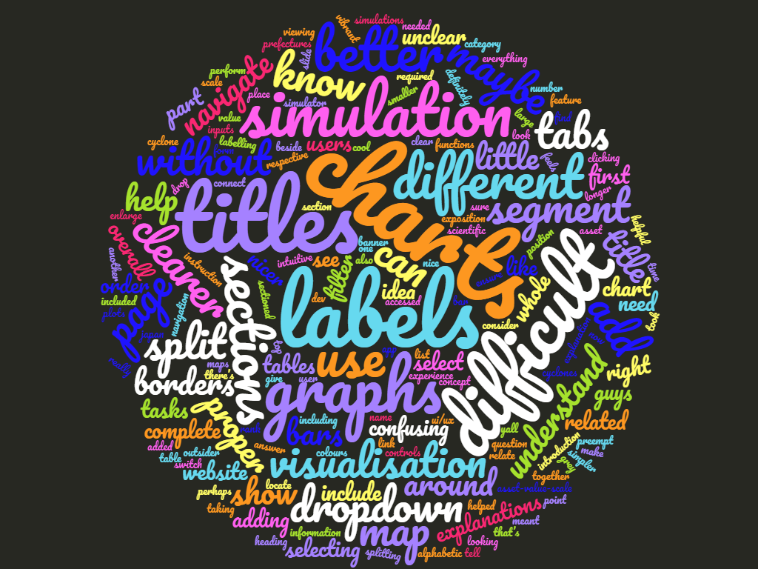
UAT Results (1st round)
Users gave feedbacks on the app:
Difficult to use
Absence of Labels and Titles on the charts
Confusing visualisations
Users want these components to be improved:
Adding of Labels and Titles on the charts and dropdown bars
Proper segmenting of all charts and better layout
Map for simulation can be locked and zoomed to area in Japan
Notes:
On top of that, we also gathered insights from the tester’s feedback. Some of the common words mentioned were “difficult”, confusing”, “cannot find”. The testers in general find it confusing and hard to use due to the absence of labels and titles on the charts. After filtering out all the improvements that testers suggested, we have derived at the top 3 priority changes the team aims to improve on. 1. Adding of labels and titles on the all the visualisations. 2. Having proper segmentations and 3. Locking japan on the map for simulation to better present on the overall application.

Slide 58
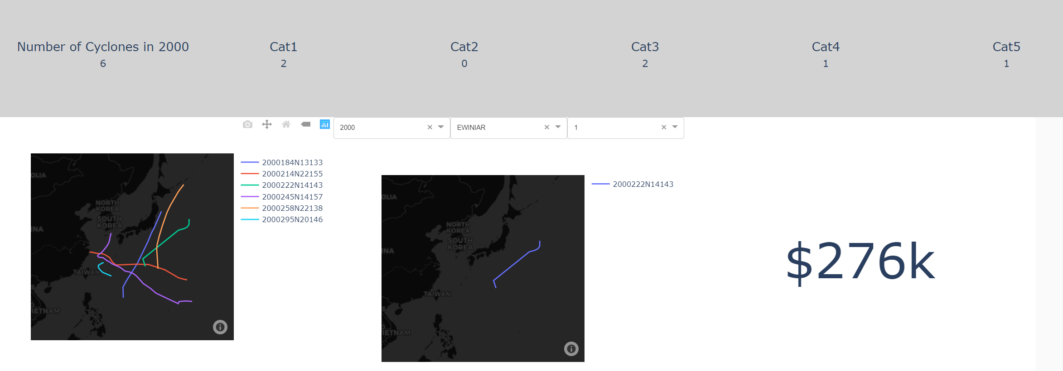
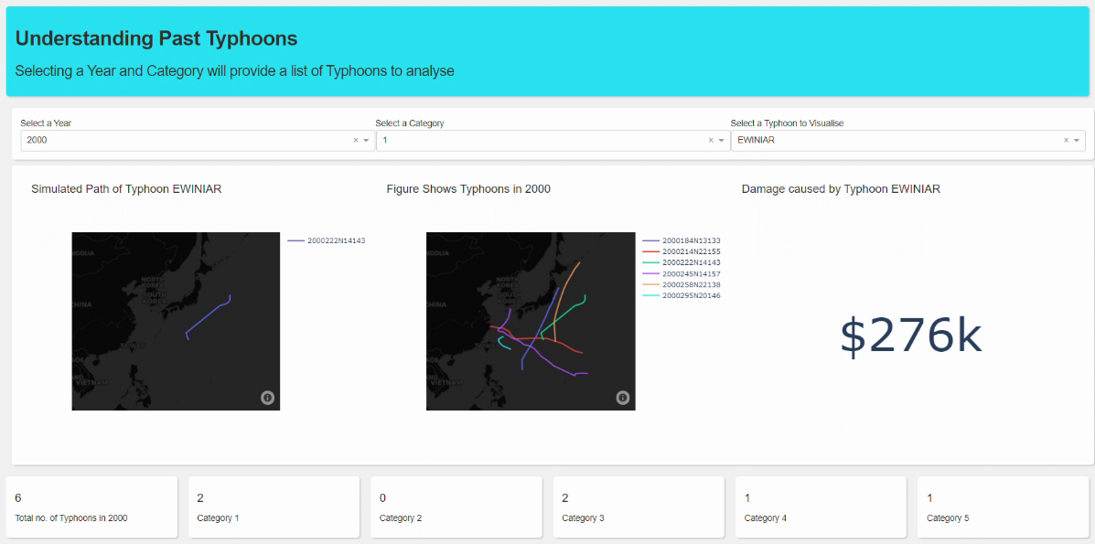
Changes #1: Adding Labels and Titles
Before
After
Notes:
Keeping in mind all the feedbacks from the testers, the team undergo another round of refinement to improve the overall usability and aesthetics of the application. The first change we improved on was the adding of labels and titles for all the visualisations we had as seen on the after screenshot below

Slide 59
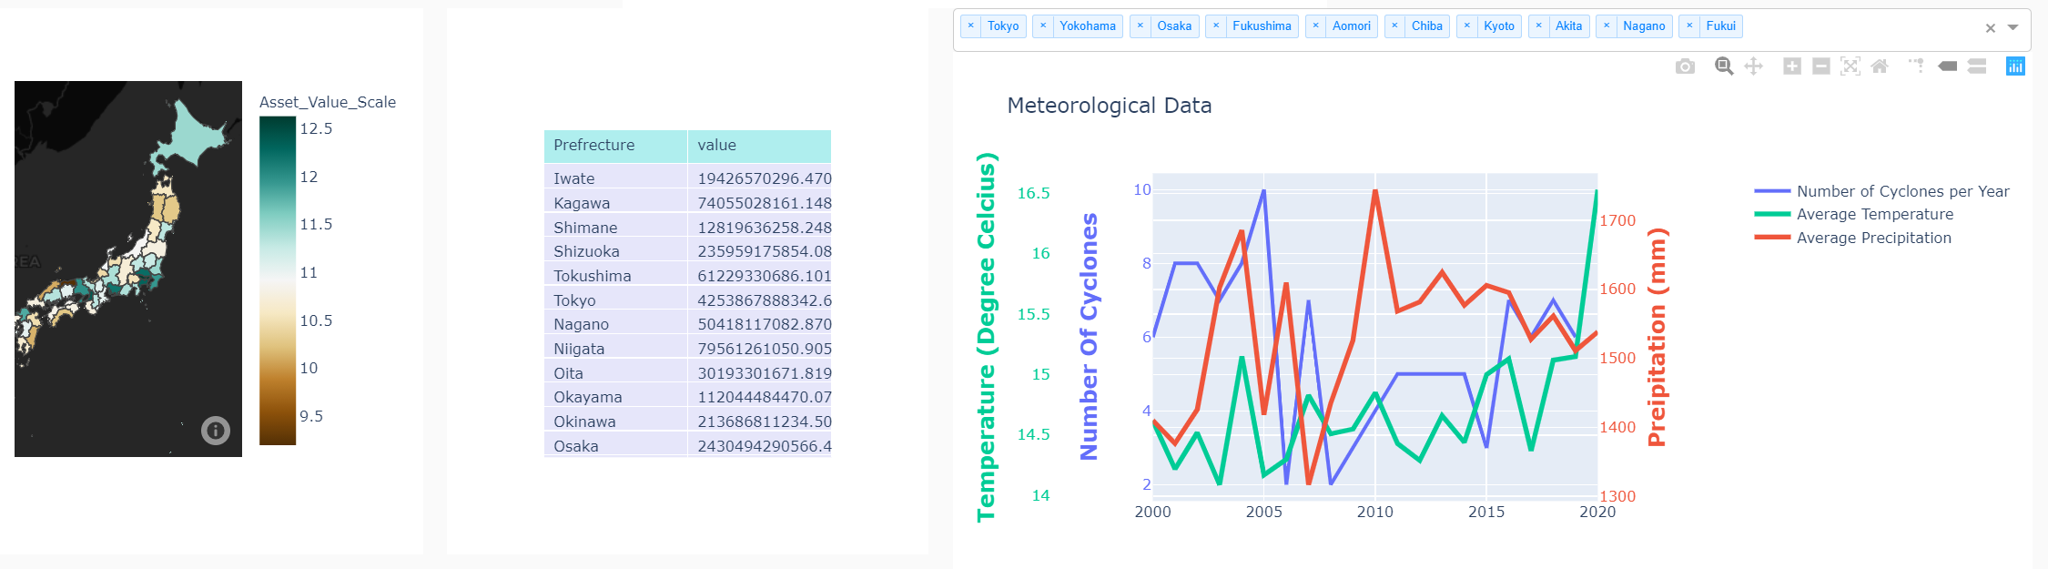
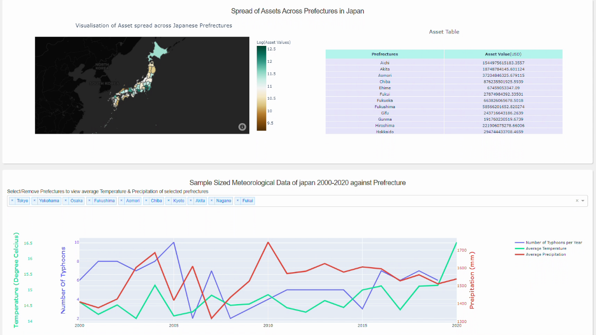
Changes #2: Proper Segmentation
Before
After
Notes:
The second change we made was having proper segmentations of the visualisations, putting related slides next to each other like the asset value scale on the map beside the asset value table. We have also increased the size of the map shown and the asset table, shifting down the chart on the temperature and precipitation to the segment at the bottom.

Slide 60
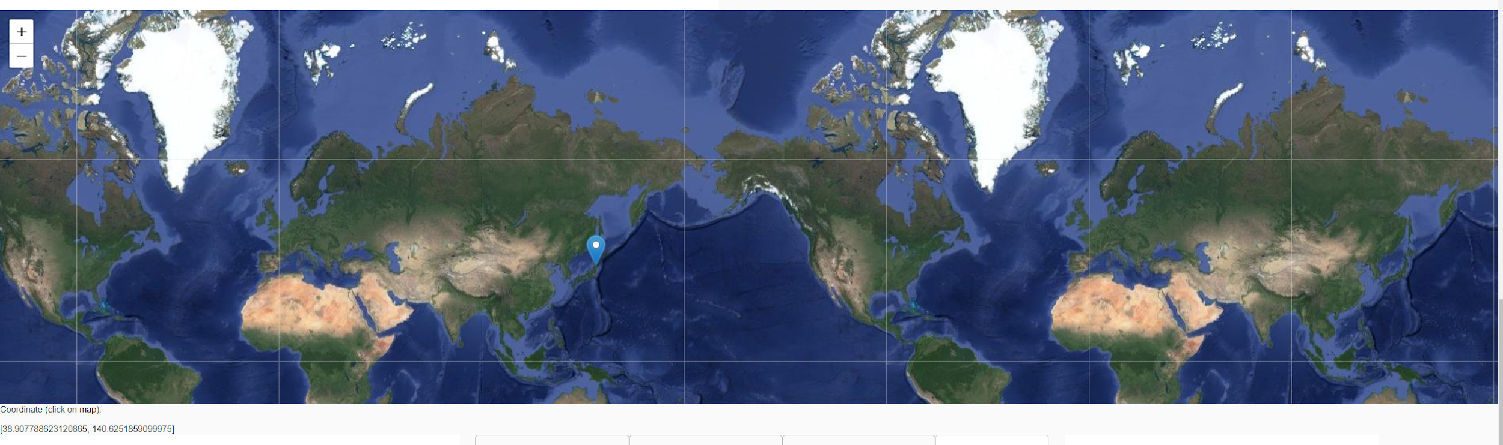
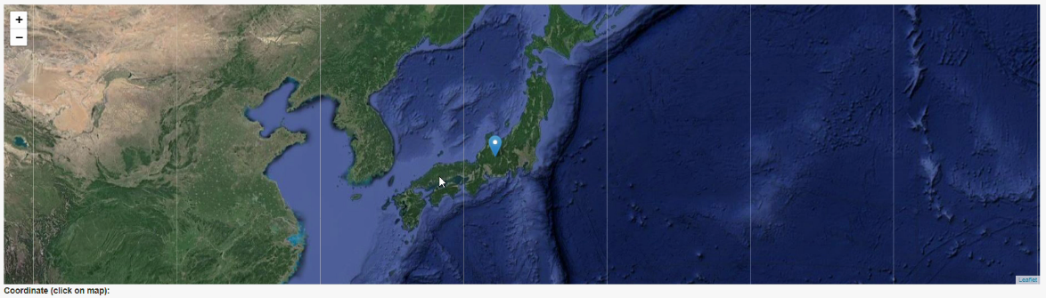
Changes #3: Area of Japan Fixed on Map (Simulation)
Before
After
Notes:
The third change we made was fixing the area of Japan on the map for the simulation. More details will be covered in the live demo by cedrick in a bit.

Slide 61
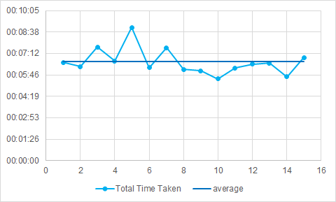
UAT Results (2nd round)
Average time taken to complete 8 tasks is ~6.5 minutes
Number of users: 15
Completion rate: 15/15
Notes:
With the improvements made to the app, we bring the app to 15 new users and had a perfect completion rate! Average time taken to complete the tasks was also greatly reduced by approximately 3.5 minutes!

Slide 62
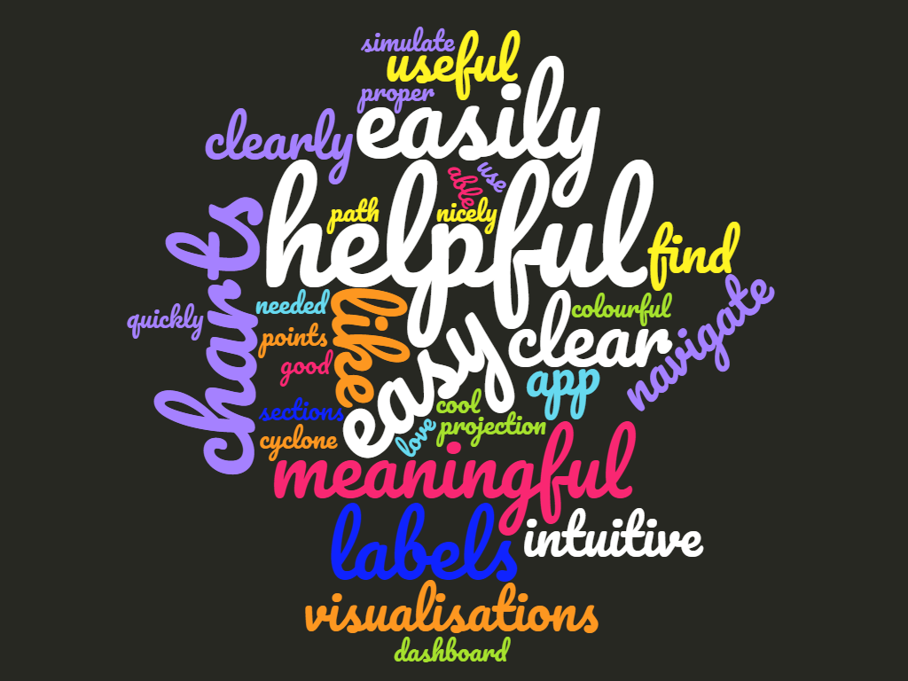
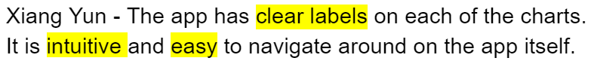
UAT Results (2nd round)
What was good about the app:
Easy to use and navigate around
Intuitive and helpful
Clear visualisations with labels and titles
Cool projection
Notes:
This time round, we also received positive feedbacks from the testers mentioning that our application is easy to use and visualisations were clearly labelled with titles. They also mentioned that the application is intuitive and the damage projection was interesting.
With all these inputs from our testers, are you ready to explore our application? Cedrick pls

Slide 63
DEMO

Slide 64
Project Management
05
Notes:
Thank you Cedrick, now I will move on to the project management.

Slide 65
Planned Timeline
Official confirmation by Client & start of project
17/08/20
Midterm presentation
15/10/20
Final presentation
TBC
Week 1 & 2
Week 5 & 6
Develop Vulnerability equation
Develop Risk formula
Set up Climada Library
Develop Impact function
Setup postgresql database
Develop Damage function
Envisioned paper prototype
Development of basic UI dashboard
Week 11
Understand client’s requirements
Confirm the final deliverables
Explore cyclone projects and research
Explore APAC map visualisation
Finalise descriptive model
1st UAT
Projection model
Simulation of cyclone
Week 9
Week 13
Improve on UI design
Documentation
Final presentation slides
Final presentation rehearsal
Finalise presentation slides
Midterm Rehearsals
Data visualization up
Preparation for live demo
Proposal
14/06/20
Negative Weeks
Week 3 & 4
Week 7 & 8
Week 10
Week 12
Internal meeting to kick start the project
Finalised Project Timeline
Meeting with client to kick start project
Research on natural disasters
Learn R Shiny Education
Collection of historical cyclone data
PowerBI visualisations
Explore financial impact of cyclone
Data collection of financial metrics
Change in scope: start on building WebApp
Integration of frontend & backend
Develop Cyclone paths based on Historical records
Visualisation coded in python
Damage function into damage table
Update Use Cases
Midterm presentation slides
Review feedbacks from presentation
Update requirements accordingly
Re-plan schedule for remaining weeks
Improve on UI designs
Prepare for UAT
1. Final UAT
2. Improvement based on UAT2
3. Improve accuracy of the model
4. Improve on UI design
5. Start preparation for final presentation
Notes:
During our Mid Terms, we had presented this slide as our project plan. We planned to finish the application by week 13 and focus on poster, report and this presentation for the rest of the weeks.

Slide 66
Revised Timeline
Final presentation
(For CS)
11/12/20
Final presentation
26/11/20
Week 11
Week 13
Week 15
Midterm Presentation
14/06/20
Research on Japan & India cyclones
Research on climate change
Case studies on cyclones in India
Revised UI layout of app
Damage Function implementation
Start working on presentation slides
UAT planning
Video Editing
Finalise poster
UAT Round 2
Finalise slides
Post-UAT app improvement
Final presentation rehearsal
Week 17
Rehearse for CS presentation
Week 10
Week 12
Week 14
Week 16
Review feedbacks from presentation
Update requirements accordingly
Re-plan schedule for remaining weeks
Improve on UI designs
Prepare for UAT
1. Financial Research on Typhoons
2. Quantification of Typhoons damage in Japan and India
3. Design UI layout for the application
1. Video Planning and Filming
2. Poster design
3. Prepare Final Presentation slides
4. UAT Round 1
5. Start working on Report
Work on Report
Revise slides for CS capstone presentation
Compile and prepare for Final submission
Notes:
However, we spent week 11 to 13 on the additional research study while building the application. Week 13 was when we started our preparation for UAT and final presentation. We conducted our first round of UAT in Week 14 which was last week. And after we made the improvements based on user’s feedback, we conducted the second round of UAT. From next week onwards, we will be putting our time into our report and revising these slides for the CS presentation on 11 december.

Slide 67
Project Management Approach
Better communication within the team
Increased Team Efficiency
More focused task
Solving problem collaboratively
Notes:
Moving on to project management approach, we were having weekly scrum to update each other about the progress. But after mid term presentation, we decided to switched to 2 day sprints which increased our efficiency. With the team closely worked together, we were more focus on the tasks and able to solve problems as a team together. In this way, we were able to make sure that everyone is on the same page.

Slide 68
Change Management
SCOPE
ARCHITECTURE
RESEARCH
We change from analysing Japan and Philippines to Japan and India
Shift from application priority to research priority
Include Climate change into both Research and Application
Application (Initial)
Flask
Django
PostgreSQL
Dashboard (Final)
Plotly
Dash
CSV data
Case Study India:
Odisha cyclone changed to Typhoon Phailin
Unable to find data for produced capital
Damage per Category model used for final damage function
Notes:
After midterms, we have also made some changes. In terms of scope, we shifted our focus from philippines to India and Japan with the reasons mentioned earlier. We also took feedback from CS seriously by also focusing on the research study suggested. And after looking into impact of climate change on typhoon and discussing it with our client, we decided to include climate change in both our research study and application.
Next, for architecture, initially, we wanted to create an application with front-end and back-end connected to a database, hence we had explored and played around with several different frameworks. However, due to the multiple shifts in the overall scope and focus, we have changed to creating a dashboard UI using plotly and dash. Instead of storing records, we have opted for the dashboard to make use of uploaded csv files for easy access and manipulation.
Lastly for the research study, we encountered many changes along the way due to data limitation.

Slide 69
Stakeholder Management
Notes:
And now moving on to stakeholder management

Slide 70
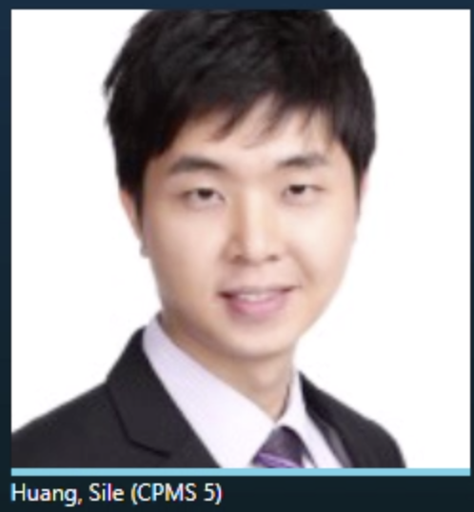

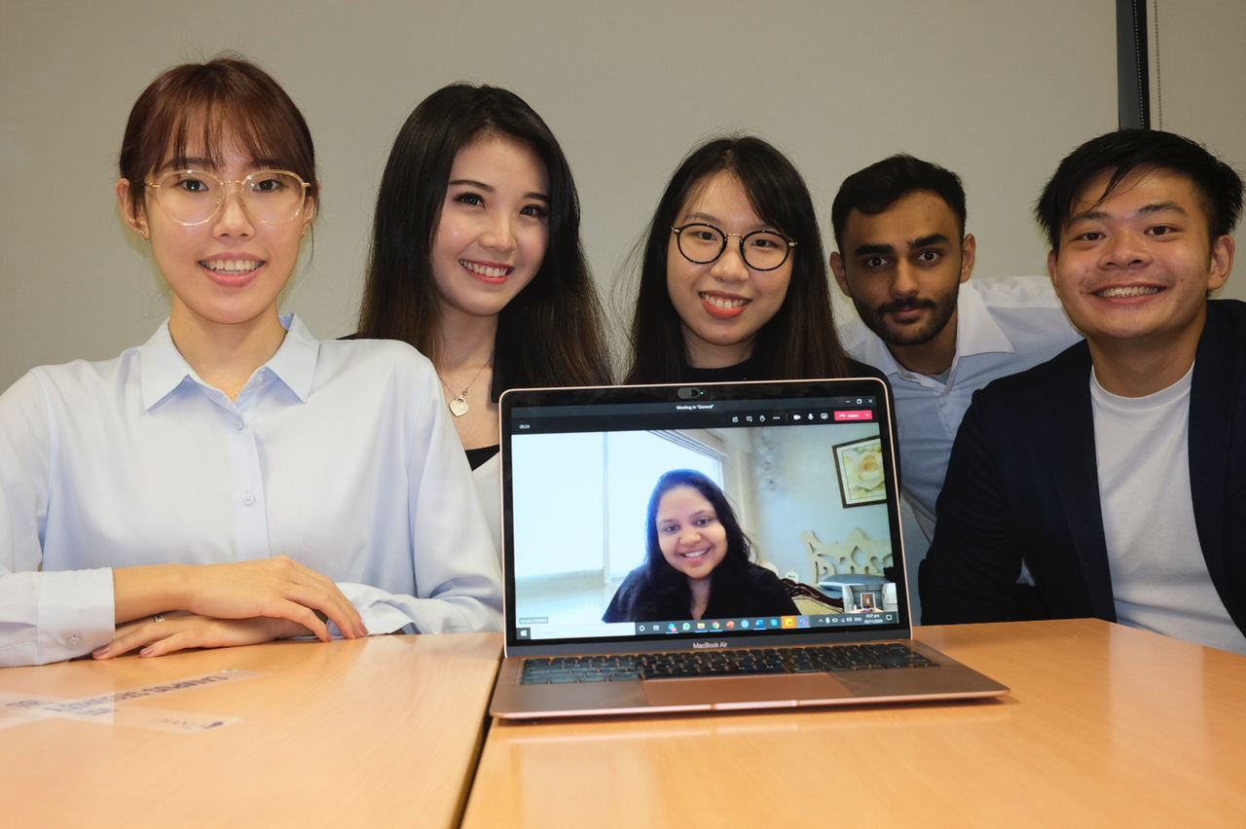


Keyholder Statistics
Mr Huang Sile
Prof Wang Hai
Cycovid-20 Team
Weekly Fixed meetings on:
Monday or
Friday
Constant Email Communication
Total meetings: 14
Weekly Fixed meetings on:
Wednesday
Constant Email Communication
Total Meetings: 10
Scrum Meetings Every two days
Communication via: Teams, Drive and Clubhouse
Total meetings: 32
Notes:
Here are the stakeholders. With Sile from CS, we meet about once a week to give him our updates and ask for suggestions and feedback on the direction of our project.
We also meet with our Professor Wang Hai weekly to show him the timeline on our progress and what we were working on
Lastly, within the team, we met a lot after the midterm presentation since we switched to a 2 day sprint approach

Slide 71
Handover Process & Plan
Items to Handover
Handover Process
 | Database
 | Source Code
 | Application Guide
 | Setup Guide
 | Use Case Diagram
 | Migration Plan
 | Research Paper
 | Credit Suisse Presentation
 | Application Demo
 | Application Guide Runthrough
 | Github Sharing
Notes:
More for CS’s side, after the end of this semester, we will need to handover the application and research results including the listed items here. And this will be our handover process starting from the 11th december presentation
Handover Checklist
Source code
User Server Set-up Guide
Metadata catalogue

Slide 72
Conclusion
06

Slide 73
Team’s X-Factor

Slide 74
X FACTOR
Plotting of Typhoon Paths
Immediate Generation of Damages
Highly Scalable
Notes:
Our teams X factors are threefold
We are able to plot and simulate a typhoon on our dashboard. A feat nevertheless
With our well researched models we are able to churn out a damages for a simulated typhoon, CS can use this feature to find the worst case scenario for an incoming typhoon
Lastly our application is not hardcoded to just work in japan. As long the data is ready, it can work for any country.
Plotting of cyclone paths
Immediate generation of damage predictions
https://docs.google.com/presentation/d/1q6deAYe8BKKOCAT-WQBmGq7FOmtBEGe7wp9jA4zRPdQ/edit#slide=id.g9c3bfb4fb4_2_1261

Slide 75
Benefits for Sponsor

Slide 76


Key Benefits
Analysing Asset Spread
Assess Trading Position
Manage Future Risk based on Climate Change
Notes:
Key benefits of app to CS
google.com/document/d/10U_Nn2TnRulQBtHMoJHJeNJ6duon40eNvWbl1nVdDio/edit
CS would like to analyse the spread of assets across the country. These assets include Human Capital, Produced Capital, Foreign Reserves. For our project we have focussed on Produced capital. Using this data they will be able to assess their trading position, which is also their lending position. Additionally, they will also be able to understand the market sentiment. By understanding the prefectures that are most affected, they can see which companies have their main operations there and hence will be able to assess their lending position with the company based on that. Lastly, they will manage the risk of future investments using the climate change data. Using our research study on India and the meteorological data given on the app they will be able to see the trend of climate change and make smart investments for the next decade.

Slide 77
GAP Analysis
STRENGTHS
1) Extensive historical data
2) In-depth breakdown per country
3) Climate change and other measures
WEAKNESSES
1) Heavy reliance on CLIMADA
2) Data sources are varied and third party information
Internal
OPPORTUNITIES
1) Increase usability of Climada
2) Improve user experience to allow greater utilisation
THREATS
1) Improvements made on Climada might render our application irrelevant
External
Notes:
Here is our swot analysis:
Our Strengths are:
We have added information about every cyclone since (i don't know) till 2018. We have information about their paths, durations and damages
Above that we also go into each prefecture or state in japan to show in depth analysis about the damage caused by the typhon
We also visualize overall typhoon damages, rainfall and temperature. Climate changes is also included into our models and charts
At the same time:
Our application relies heavily on CLIMADA. Any problems with climada integration cases problems in our application. So down the road if any we are moving the application, and climada in incompatible. Our application will be incompatible
Our data collection sources were from multiple different news sources and organisation. If there are inconsistencies in the data, our app will have those inconsistencies
We also face the biggest threat of CLIMADA os new patches and updates that might completely break our application.
However on the bright side, CLIMADA has also made our application very comprehensive. While the devs continue to update climada, our application will also get better and more accurate. We also want to bank on this to improve our UI/UX
SWOT
Threat and opportunities to a certain extent
Opportunities:
Leverage on Climada
Build from it, increased usability, improve user experience
Threats:
Dependent on Climada
Improvements made on Climada: application no longer relevant

Slide 78
Future Steps
1
Dashboard for India & Other Typhoon-Prone Countries
2
Calculate Damage for other Assets
3
Typhoon Data and Real-time Data Scraper
4
Migration into CS Internal Application
5
Improve Accuracy of Model Predictions
Notes:
Lets talk about future plans:
We hope to add Indian Typhoon data and other countries data into the app to show scalability
As mentioned we want to maybe help migrate the application into CS architecture
Adding a typhoon data scraper would really help the application stay up to date with new typhoons
We have now only covered produced capital, we can scale this further to include foreign reserves, natural capital and human capital
Finally to continue adding data and improving our models for a higher accuracy

Slide 79
Team Reflection
It was a great experience of building the app by exploring different options along the way. As the project manager, I have also gained experience in how to manage the team and stakeholders. More importantly, I also learned how to be a responsible team players.
The project has been a great learning journey and definitely a very unique one, given the change in how meetings were conducted. It was an eye-opening experience to have financial elements incorporated into the application. Through this project, I’ve learnt that communication is key in determining the overall efficiency and productivity of the team.
Data collection is hard. You never notice the importance of news stations and weather reports until you try to collect info.
It has been a fulfilling learning journey as we managed to accomplish the tasks we have set out to do despite many changes in the project scope. Through the ups and downs, I have gained the skill of adaptability to cope with changing requirements from the clients. I am glad to embark on this journey with my team and it is definitely an eye opener and a fruitful project to work on.
The project has been an enriching experience. I was exposed to a lot of new things - the finance world, front-end development, new softwares and solutions. The biggest lesson I’ve learnt is the importance of understanding requirements and communicating them correctly.
This project is quite different from other projects that I have done for the last 3 years. It combines all the techniques and knowledge I learned from different courses such as IDP and SPM. It was a great experience of building something from the scratch to apply in the real world situation with my teammate
Notes:
The last thing we want to touch on is our teams reflections and learning exp. Parth learnt a lot about data collection. Shivika exp was tied to new technologies and frameworks. Jia yu experienced a new form of project mgmt. For Christine, it was all about task allocations and importance of being adaptable. Xiao Wei believed this was an amalgamation of everything she has learnt in the last few years in SMU and the real world application of it.

Slide 80
Thank You!
We can now answer any questions you may have

